Slide 1
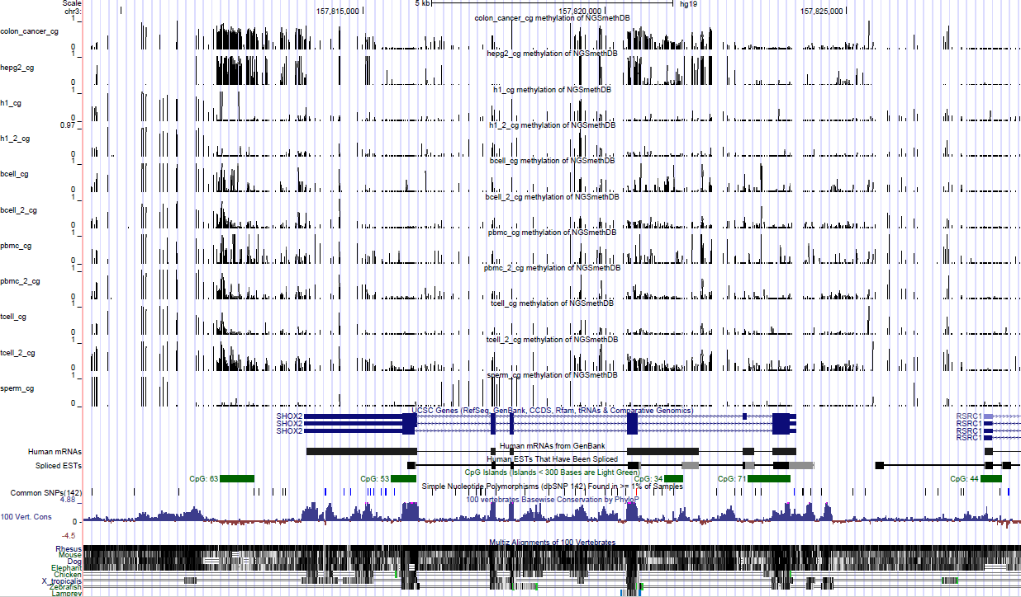
SHOX2： hyper-methylation in cancers
chr3:157820497-157820970

Slide 2
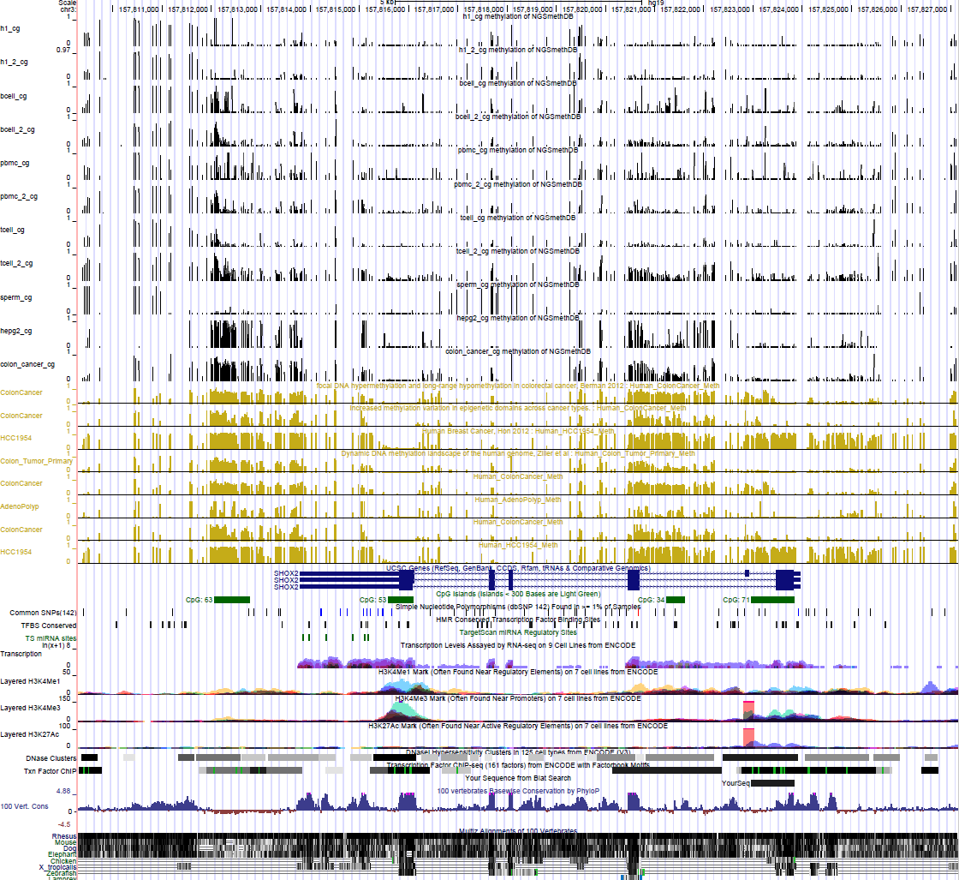
SHOX2： hyper-methylation in cancers
chr3:157,813,129-157,813,633
chr3:157,820,643-157,821,696

